Slide 1
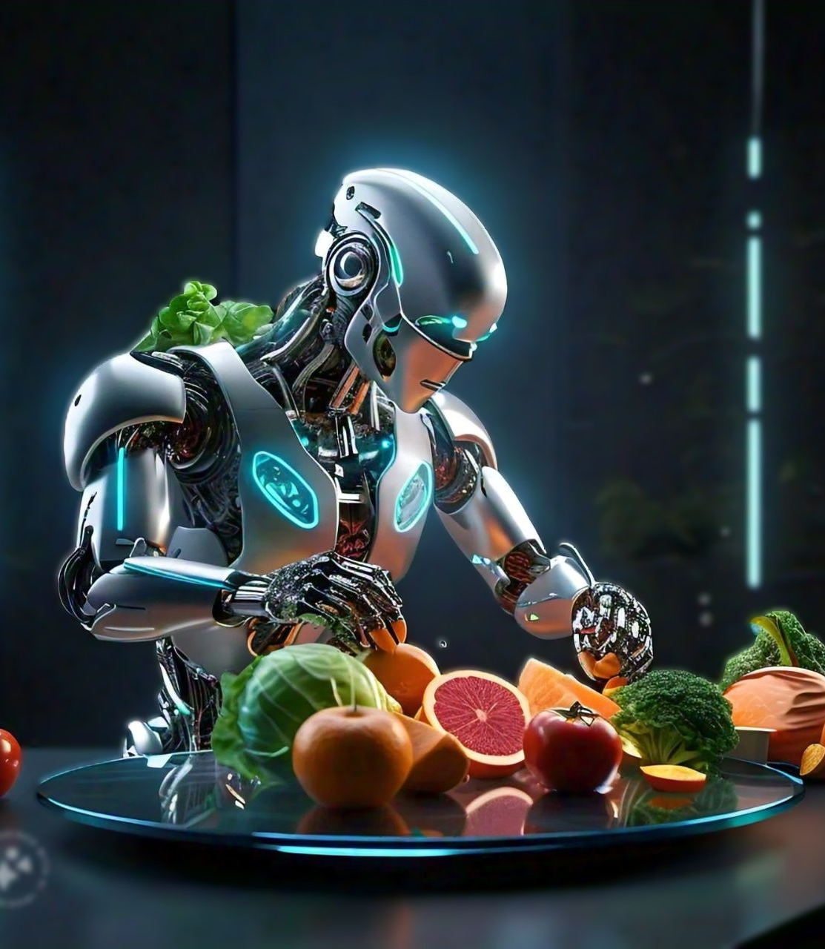
NUTRIFLEX.AI
Balanced Nutrition, Better Living!
Rahul Patil

Slide 2
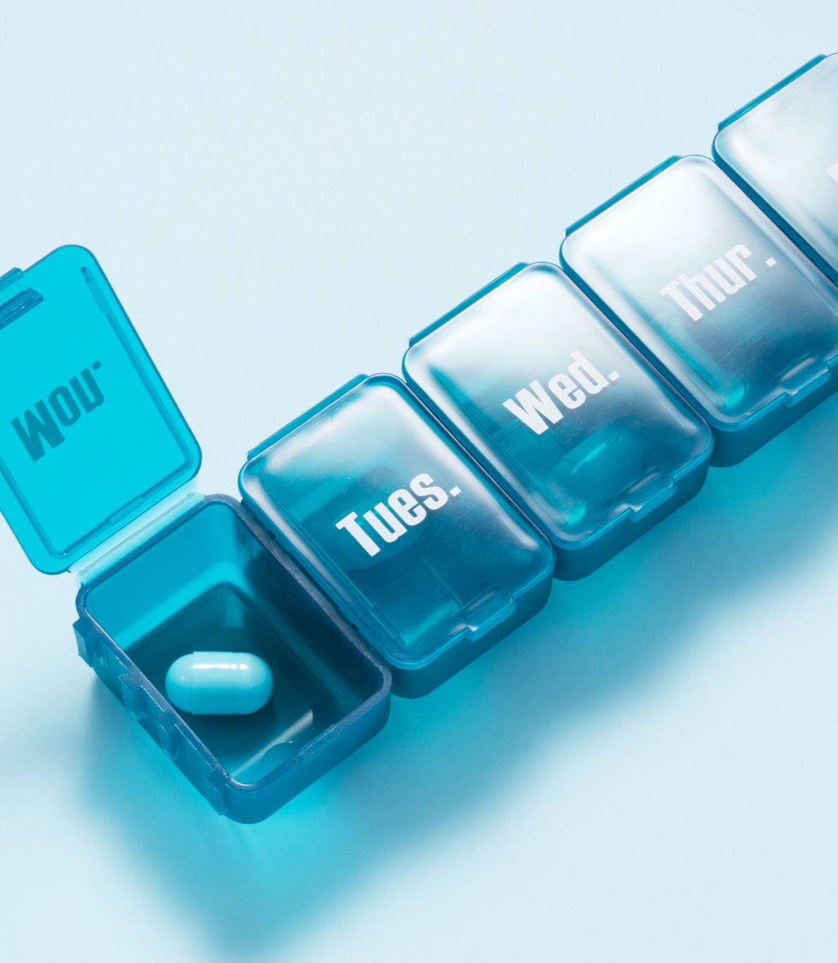
EXECUTIVE SUMMARY
NUTRIFLEX.Ai is an AI-driven nutrition assistant designed for personalized meal planning, calorie prediction, and smart recipe recommendations.
Integrates machine learning models for accurate predictions and insights.
Incorporates gamification to engage users and a goal-tracking feature for personalized health management.

Slide 3
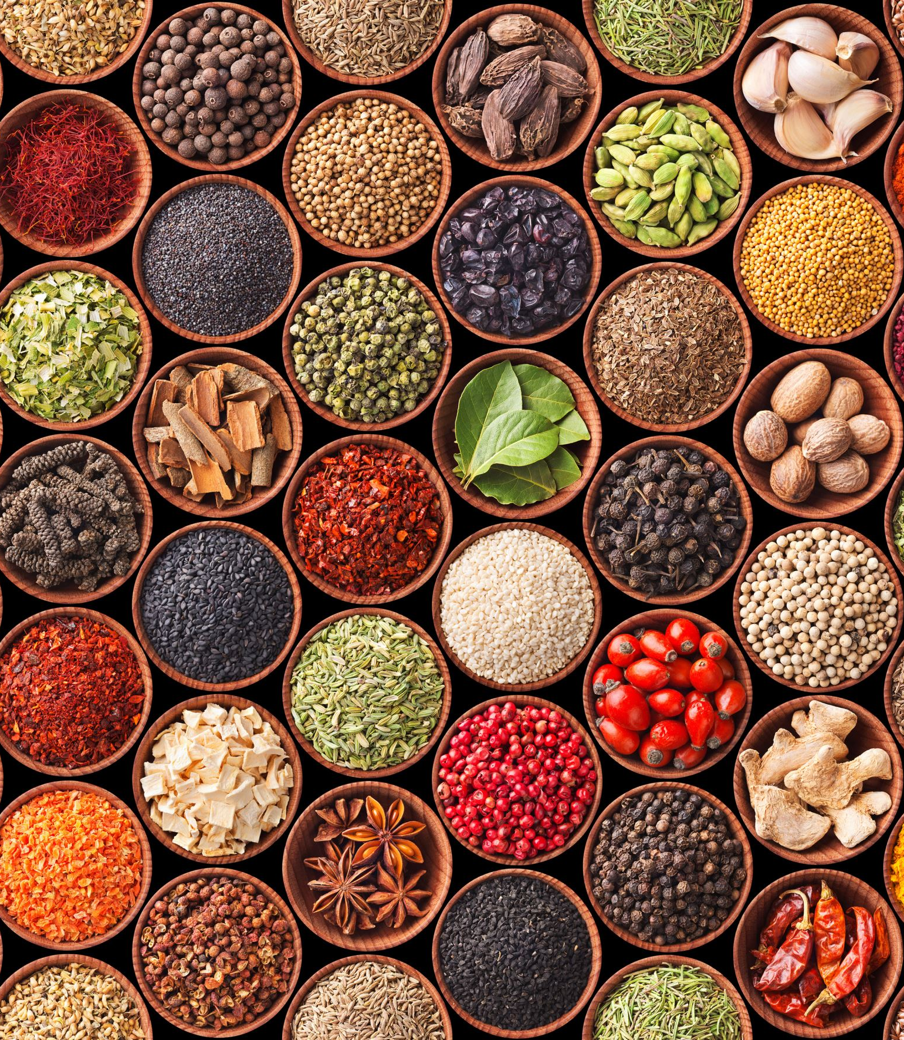
PROJECT OVERVIEW
Features:
BMR and TEE calculation for meal planning.
Calorie content prediction using ML models (Random Forest, XGBoost, Gradient Boosting, CatBoost).
Traditional and smart recipe suggestions.
Gamification for healthier eating habits.
Health goal tracking with dynamic meal suggestions.

Slide 4
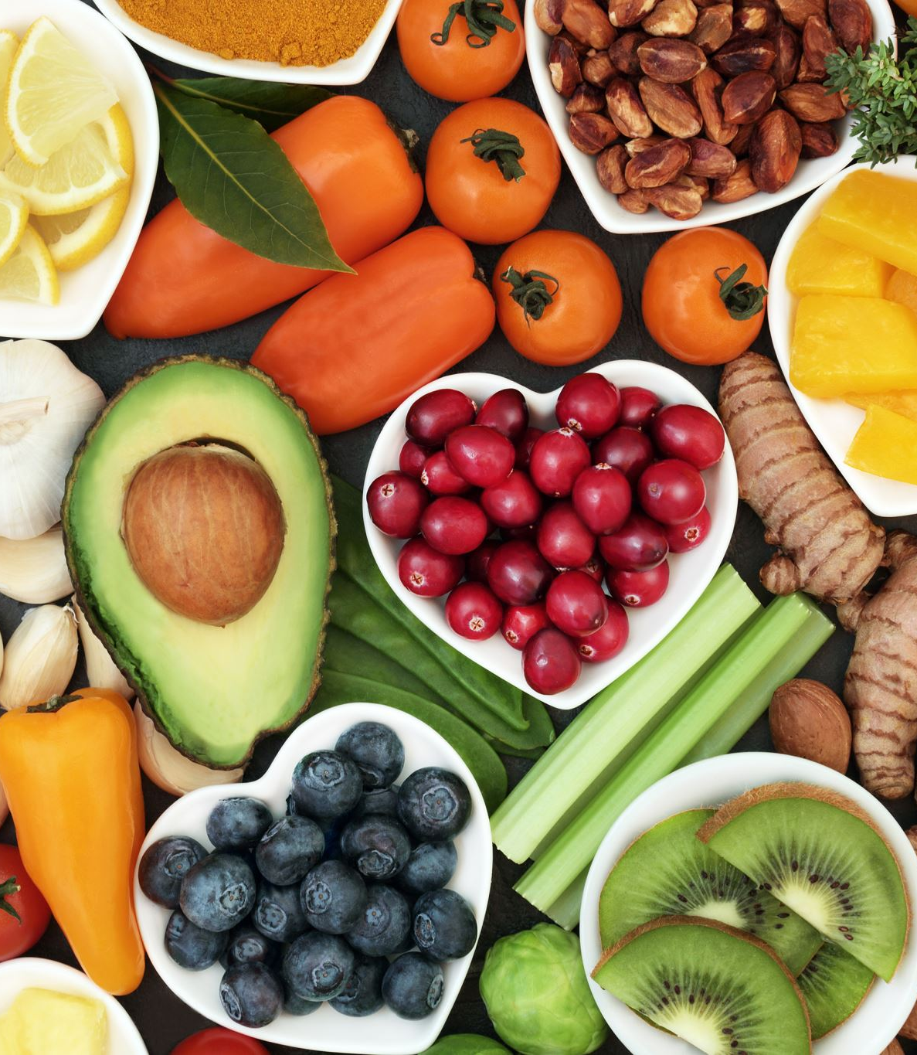
INTRODUCTION TO PERSONALIZED NUTRITION
The Need: Increasing demand for personalized nutrition to prevent lifestyle-related diseases.
NUTRIFLEX's Solution: Simplifies nutrition management using AI, combining calorie prediction, meal planning, and recipe recommendations.

Slide 5
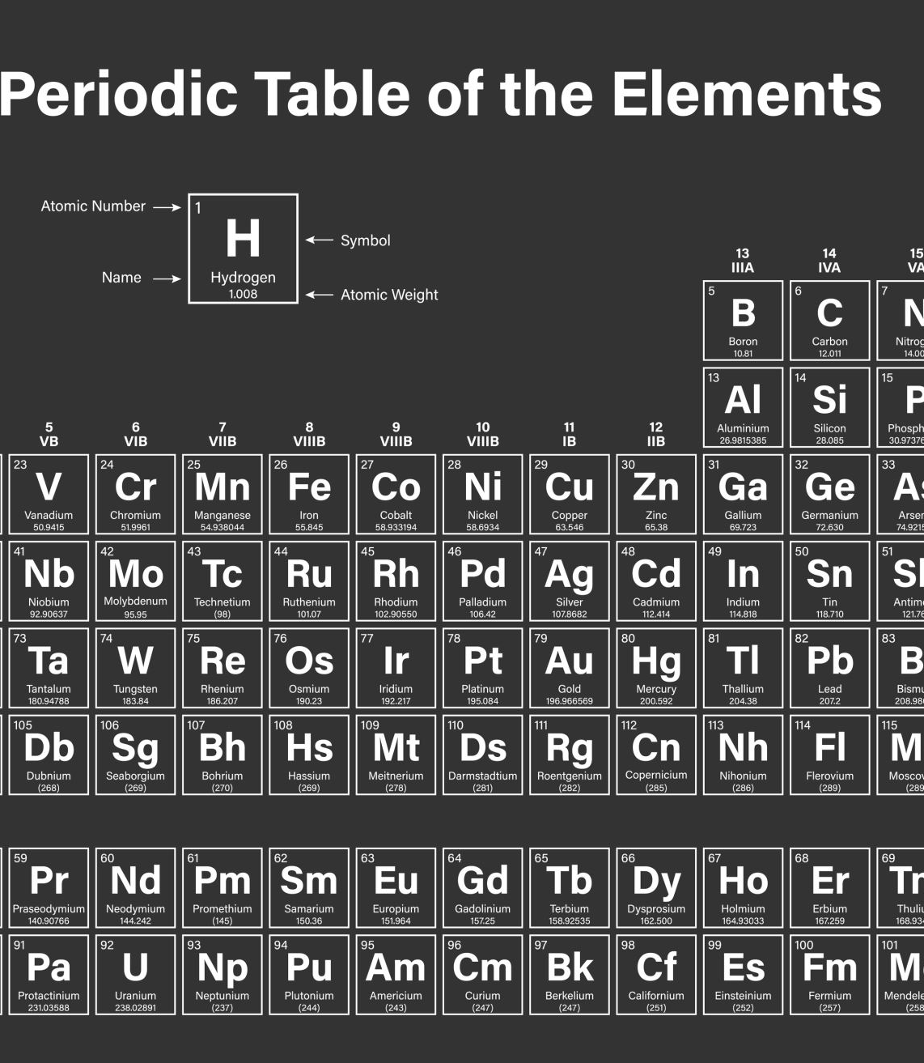
METHODOLOGY
DATA PREPROCESSING:
One-hot encoding of categorical data and scaling of numerical data using StandardScaler.
CALORIE PREDICTION MODELS:
Random Forest
XGBoost
Gradient Boosting
CatBoost
BMR AND TEE CALCULATION: MIFFLIN-ST JEOR EQUATION TO GUIDE MEAL RECOMMENDATIONS.

Slide 6
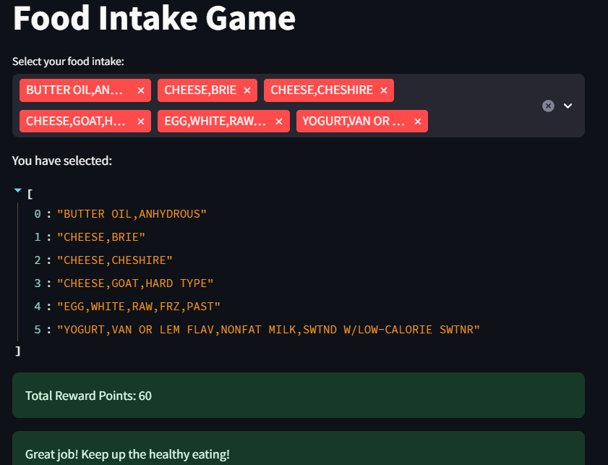
GAMIFICATION AND REWARDS
Food Intake Game: Users earn points for healthy food choices.
Goal: Increase user engagement and promote healthier eating through rewards and achievements.

Slide 7
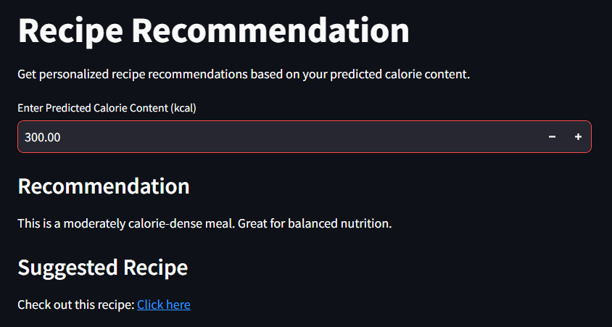
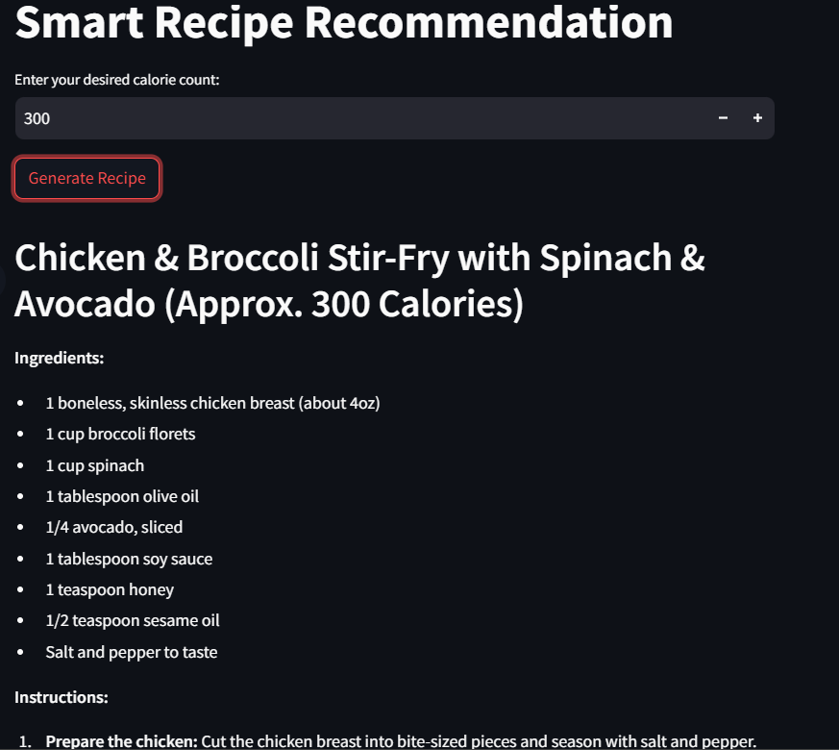
RECIPE RECOMMENDATION SYSTEM
Traditional Recipes: Based on calorie thresholds.
Smart Recipes: AI-generated based on user input, including calorie targets and macronutrient breakdowns.

Slide 8
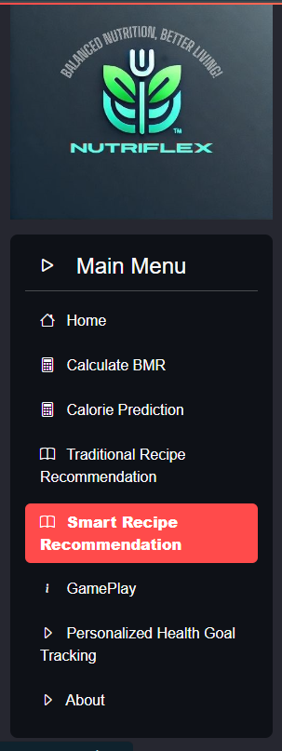
USER INTERACTION
Simple Interface: Built with Streamlit, featuring a sidebar for easy navigation.
Sections:
Home
BMR & TEE Calculator
Calorie Prediction
Recipe Recommendations
Gamification
Health Goal Tracking

Slide 9
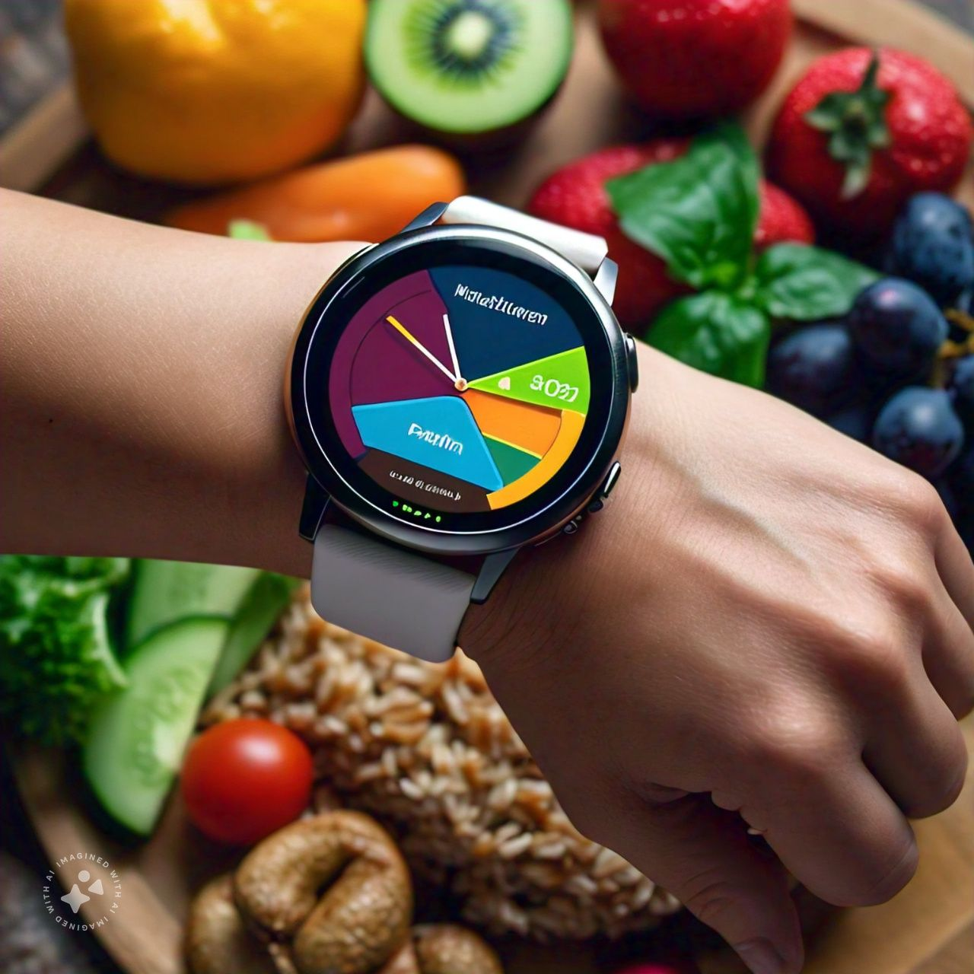
INTEGRATION WITH WEARABLES
Future Plan: Integrating NUTRIFLEX.Ai with wearable devices for real-time activity tracking and dynamic meal plan adjustments.
Benefits: Increased accuracy with real-time activity data.

Slide 10
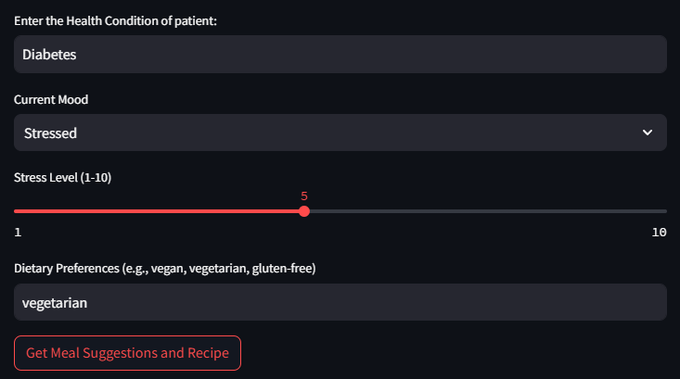
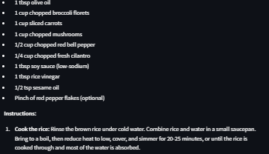
ADDED FEATURES
User-Defined Protein Intake:
Users can set their preferred daily protein intake
NutriFLEX.Ai adjusts meal and recipe recommendations accordingly
Allergy Awareness:
Users can input specific allergens (e.g., gluten, nuts)
NutriFLEX.Ai excludes these allergens in meal suggestions
Smart Health Feature:
Mood-Based Meal Suggestions:
Users can input their mood (happy, stressed, etc.)
NutriFLEX.Ai suggests meals to boost mental well-being and health

Slide 11

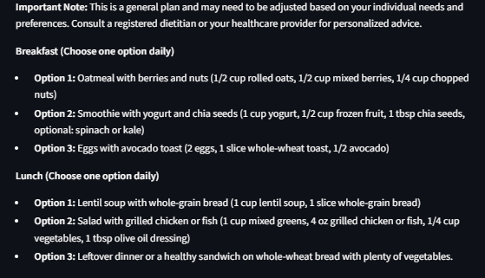
GUT BACTERIA ANALYSIS
Gut Microbiome-Based Recommendations:
Inputs on Gut Bacteria:
Users provide data on their gut microbiome levels (e.g., Lactobacillus, Bifidobacterium)
Information on harmful bacteria (e.g., Clostridium difficile)
Meal Plans to Improve Gut Health:
AI generates personalized meal plans to enhance microbial diversity
Focus on reducing harmful bacteria and increasing beneficial bacteria

Slide 12
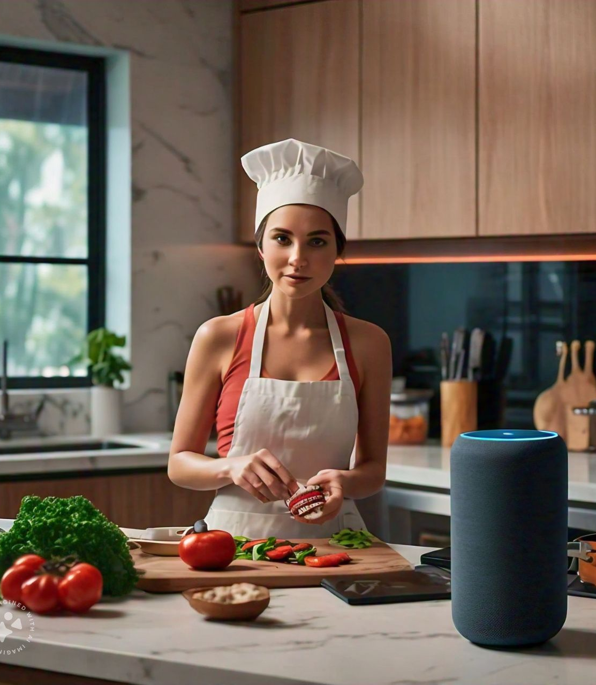
VOICE ASSISTANCE FEATURE
Upcoming Feature: Voice command support for hands-free interaction.
Example Commands:
“Calculate my BMR.”
“Suggest a 500-calorie recipe.”

Slide 13

RECIPE INTEGRATION WITH FOOD DELIVERY SERVICES
Future Plan: Integration with Zomato, Swiggy to allow users to order ingredients or meals directly from the app.
Benefits: Seamless transition from meal planning to execution. More accessible nutrition through delivery services.
ThePhoto by PhotoAuthor is licensed under CCYYSA.

Slide 14
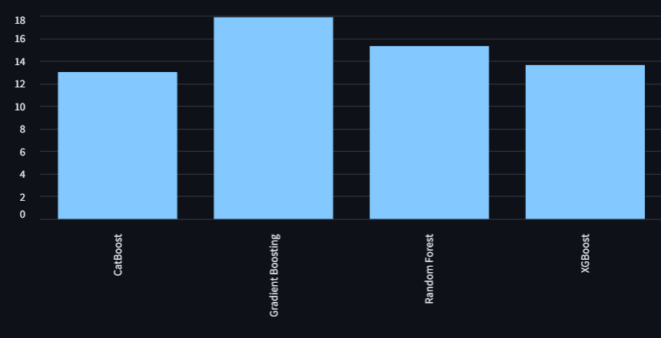
MODEL PERFORMANCE
Calorie Prediction Models:
Performance comparison between Random Forest, XGBoost, Gradient Boosting, and CatBoost.
Initial tests showed Gradient Boosting as the most accurate, but further tuning is needed.

Slide 15
USER FEEDBACK
Gamification Enhancements: Users suggested expanding challenges (e.g., weekly targets, community-based competitions).
Wearables Integration: Strong interest in automatic TEE adjustments.

Slide 16
FUTURE WORK
Enhanced gamification with badges and social features.
Integration with wearables and voice assistance.
Expanded recipe database with local and international options.
Inclusion of dietary preferences and allergies in meal plans.

Slide 17
CONCLUSION
NUTRIFLEX offers an innovative solution for personalized nutrition through AI and user engagement.
Future iterations will further enhance functionality, making the app more interactive and tailored to individual needs.

Slide 18

Rahul Patil (NUTRIFLEX.AI)
rp3252154@gmail.com
8291216667

